Slide 1
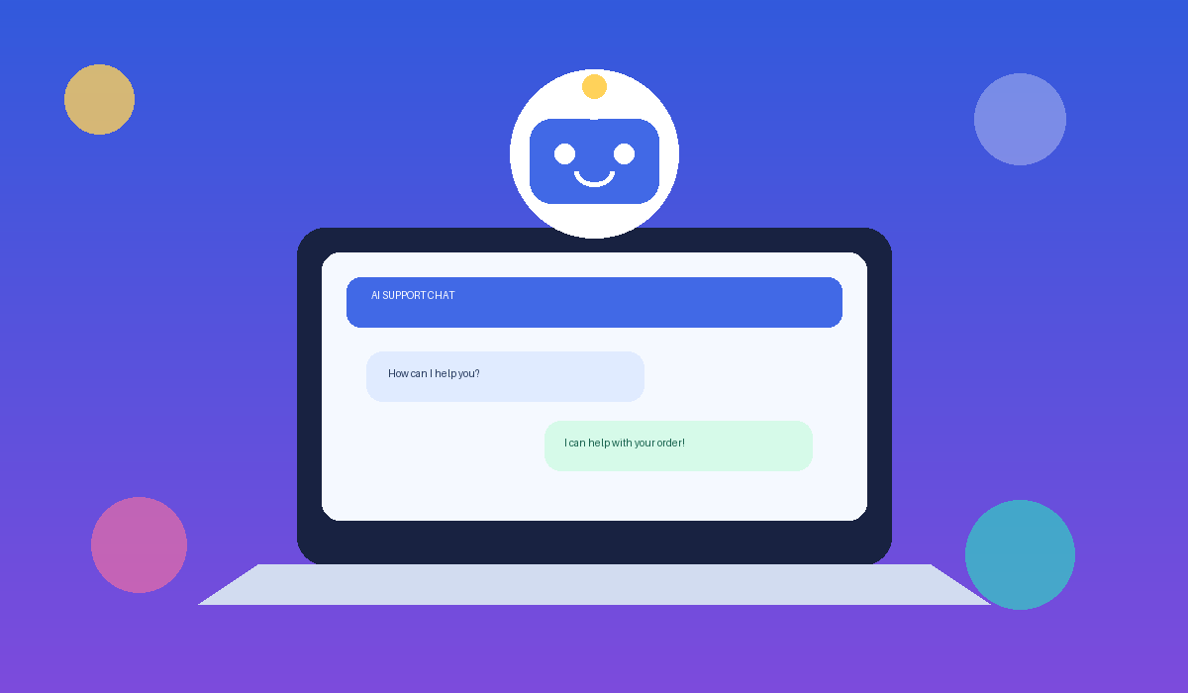
AI-BASED
CUSTOMER SUPPORT CHATBOT
A simple chatbot that answers customer questions using AI.
PROJECT PRESENTATION BY
JASWANTH KORRA
RAJU VANTHALA
1/5

Slide 2
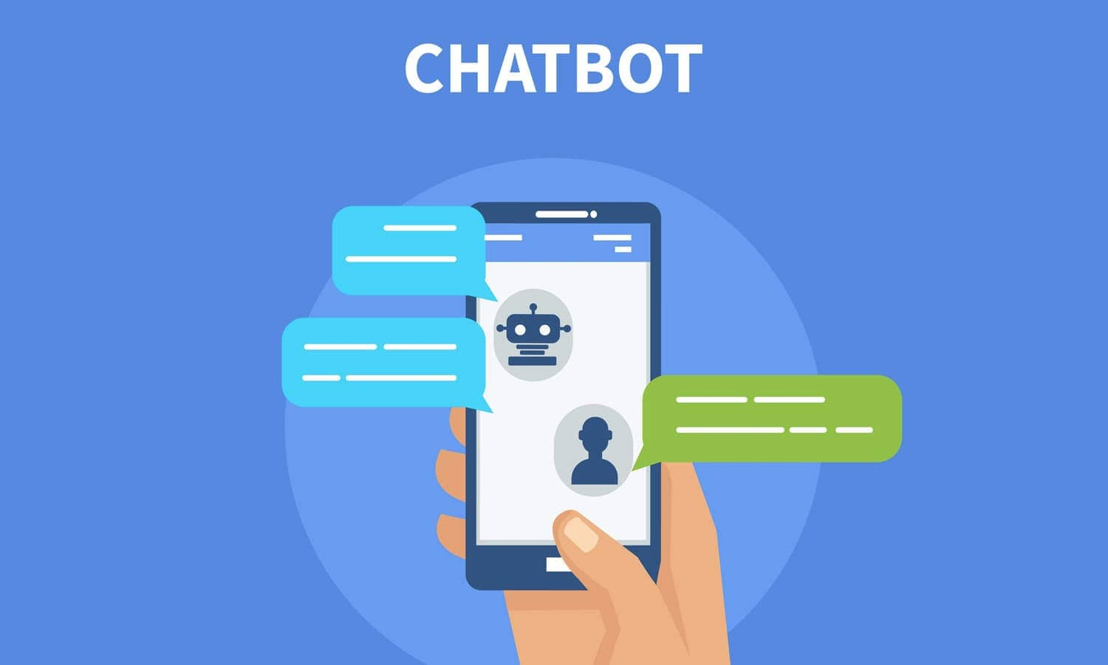
PROJECT OBJECTIVES
What should the chatbot achieve?
• Answer common customer questions
• Provide quick support at any time
• Reduce repeated work for support staff
• Improve customer satisfaction
Goal: helpful answers with less waiting.
1/5

Slide 3
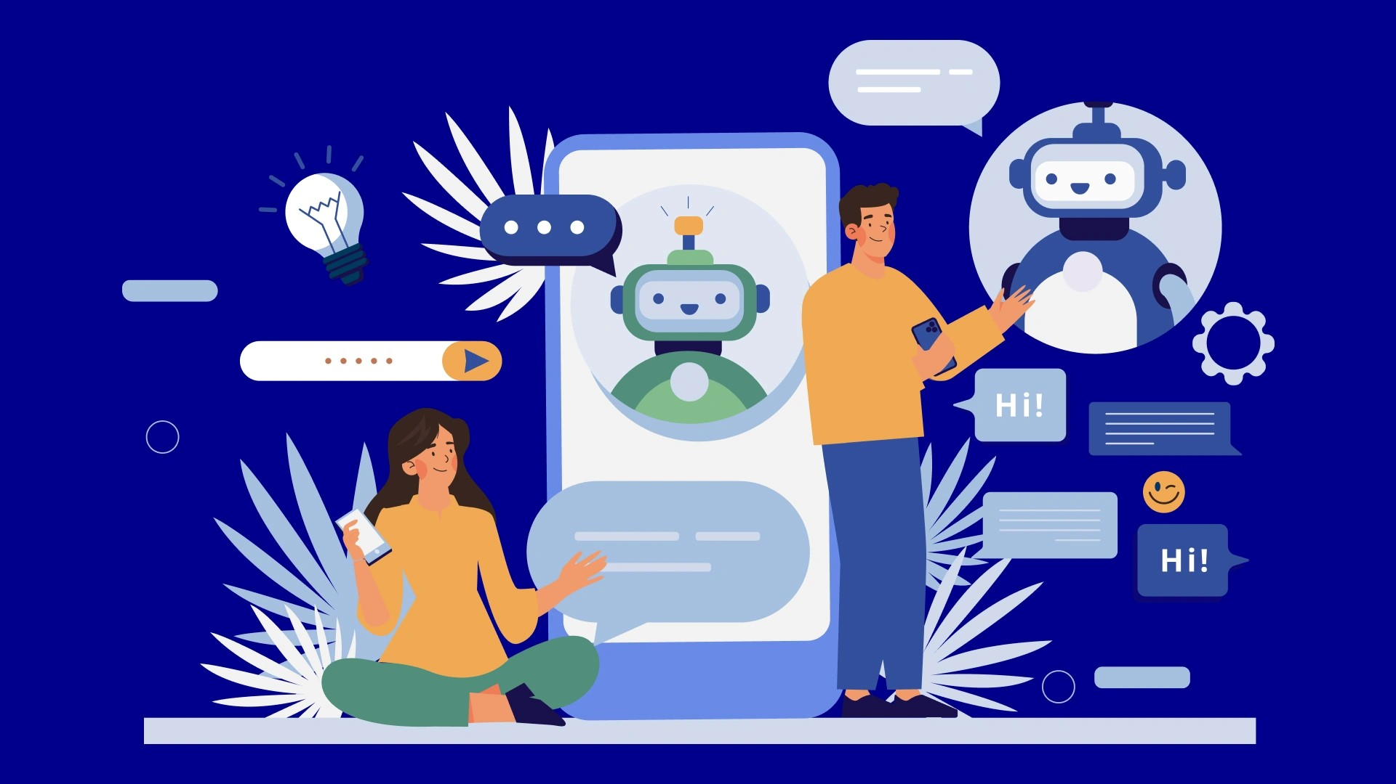
KEY FEATURES
Simple functions customers can use
• Chat box to type questions
• Automatic AI-generated replies
• Answers to frequently asked questions
• Clear messages and error feedback
• Optional chat history
2/5

Slide 4
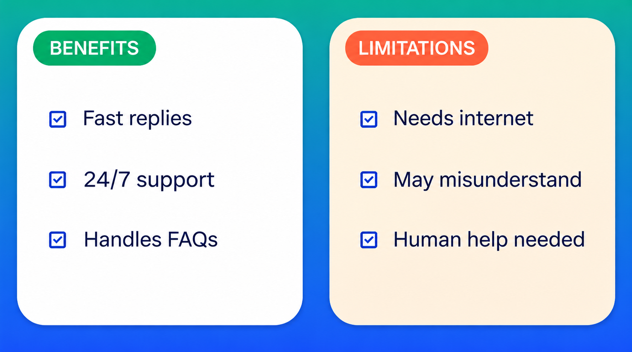
BENEFITS & LIMITATIONS
BENEFITS
• Fast answers to common questions
• Can support users 24/7
• Reduces repetitive tasks
LIMITATIONS
• Needs internet and a working AI API
• May misunderstand unclear questions
• Complex issues may need human support
4/5

Slide 5
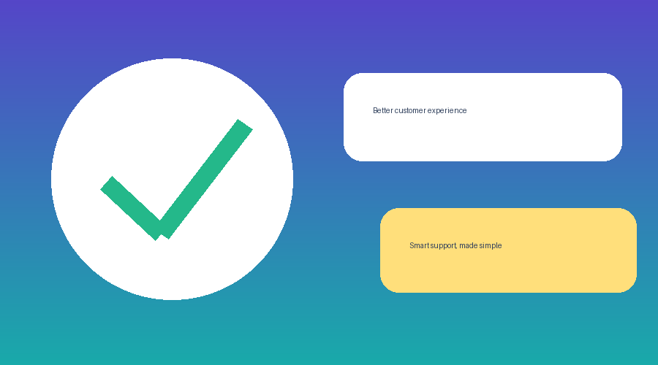
CONCLUSION
An AI-based customer support chatbot can provide quick answers and make online support more efficient.
FUTURE IMPROVEMENTS
• Support Telugu and other languages
• Add voice chat
• Improve answers using feedback
THANK YOU!
https://prodvercelchatbot.vercel.app/
5/5

